Slide 1
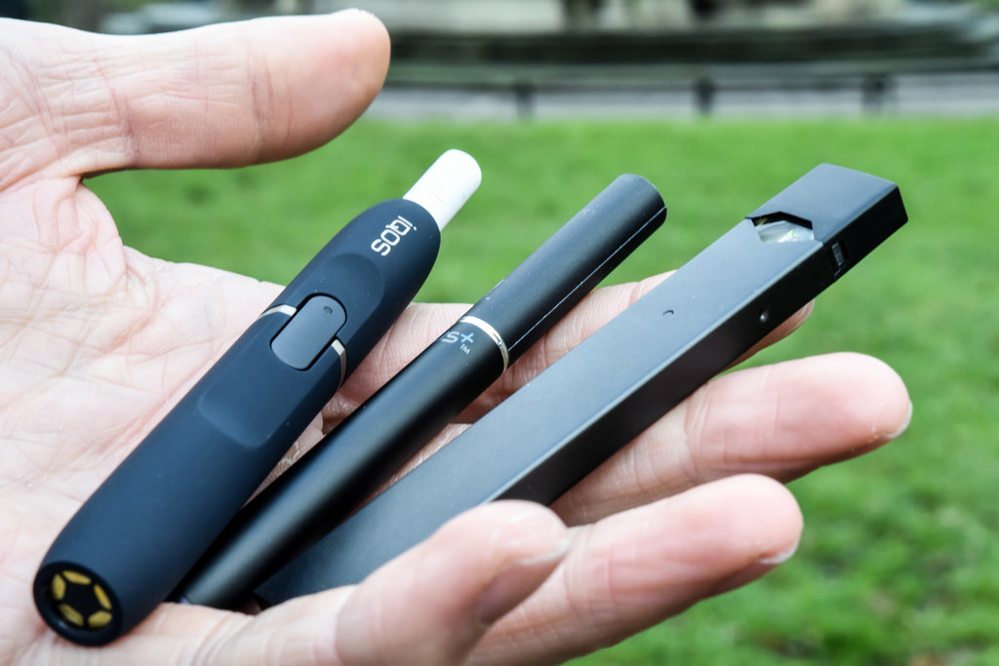
Vaping

Slide 2
What is vaping?

Slide 3
Vaping describes someone who uses an e‐cigarette – a battery‐powered inhaler – that is designed to mimic traditional cigarette smoking. E‐cigarettes are devices that use a cartridge to deliver an aerosol mist containing nicotine with various flavors. This aerosol mist is commonly called a “vapor”.

Slide 4
Is vaping common at NT?

Slide 5
The 2016 Youth Risk Behaviors Survey of NT students indicated that 19% of NT students have used an e-cigarette in the 30 days prior to the survey and 6% of 9th graders (class of 2020) indicated using an e-cigarette in the 30 days prior to the survey.

Slide 6
Is vaping harmful?

Slide 7
Many vape pen users assume that they are protecting their lungs because they’re inhaling vapor, not smoke. No tar, no carcinogens, right? Wrong. Aside from nicotine and artificial flavoring, it’s hard to know what else might be hiding in the ingredients of any brand of e‐cigarette. Traces of metals like iron and copper are often detected—as well as the carcinogen diethylene glycol.

Slide 8
Why do people vape?

